Slide 1

MINOR PRESENTATION
MENTOR: DR. VELIDI V S S GURUNADH
TEAM MEMBERS: ABHISHEK SHARMA, ANKUR, ANIRUDHA JAIN, SOHAIB GHAZALI

Slide 2
AIM OF PROJECT
The objective of the project is to design, fabricate and testing of axial turbine blades in a cascade wind tunnel and hence compute the blade efficiency.

Slide 3
INTRODUCTION
Axial turbines are commonly used in aircraft industry. In this type of turbines the fluid moves in an axial direction through the rotor and as compared to centrifugal type turbines, they can handle greater mass flow and are highly efficient.
The main function of the axial turbine is to convert pressure energy and heat energy into kinetic and mechanical energy.

Slide 4
INTRODUCTION
We have chosen an axial turbine instead of an axial compressor because of the following reasons:
The efficiency of an axial turbine is higher than that of an axial compressor because axial turbine blades do not undergo boundary layer separation due to favourable pressure gradient.
It is easy to design and manufacture

Slide 5
BASIC EQUATIONS
Euler work equation
Similar to Newton’s 2nd law of motion, which describes how torque and angular momentum are related i.e. the net torque will be equal to time rate of change of angular momentum
Following the equation a similar expression can be derived for the specific work done by the axial blade:

Slide 6
VELOCITY TRIANGLES
When studying turbines, velocity triangles are used in order to get an understanding of how the flow interacts with the blades. The fluid enters the stator where it is usually accelerated to some degree in the absolute frame of reference. It then enters the rotor where the flow normally experiences acceleration in the relative frame of reference. The absolute velocity can be calculated by vectorially adding the relative velocity component and the blade velocity:

Slide 7
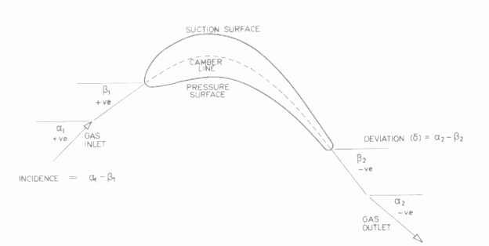
BLADE PARAMETERS

Slide 8
BLADE PARAMETERS
1. DEGREE OF REACTION
The degree of reaction is defined as:
2. BLADE LOADING COEFFICIENT
The blade-loading coefficient is used to express work capacity of the stage. It is defined as the ratio of the specific work of the stage to the square of the blade velocity—that is, the blade-loading coefficient or temperature-drop coefficient is given by:

Slide 9
BLADE PARAMETERS
3. FLOW COEFFICIENT
The flow coefficient is defined as the ratio of the inlet velocity to the blade velocity U, i.e.
4. BLADE EFFICIENCY:

Slide 10
METHODOLOGY
1. Calculation of blade profile dimensions
2. Generate 3D computer models using CATIA V5
3. 3D flow analysis using CFD
4. Fabrication of designed rotor blade
5. Cascade Wind tunnel testing
6. Conclusion of results

Slide 11
TIMELINE

